Slide 1
Tutorial 2 – Bash & Scripting
18 September 2020
MICB405

Slide 2
Utilities Review
cd (change directory)
ls (-l) (list files) (-long)
pwd (print working directory)
cp (copy)
rm (-r) (remove) (-recursive)
mv (move)
cat (concatenate)
echo (print content you provide as argument)

Slide 3
More Utilities…
grep (global regular expression print)
less (less = more
head/tail (self-explanatory)
wc (-l, -w, -m) (wordcount) (-lines, -word, character)
sort (sort lines)
uniq (unique lines)
chmod (change mode)
mkdir (make directory)

Slide 4
Advanced Utility
awk
Not short for anything – does file processing based on lines & columns

Slide 5
Special Characters
> (redirect)
>> (append)
< (redirect, again)
| (pipe) (not 1, l, or I)
; (separate command)
&& (AND) || (OR)

Slide 6
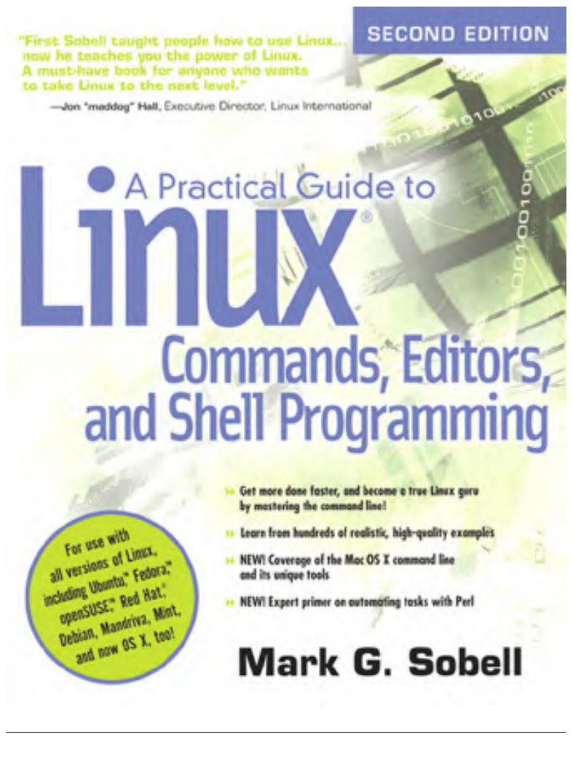
Review

Slide 7
In-terminal Text Editors
nano = easiest
nano filename.txt
vim = more advanced
Rich keyboard shortcuts but steeper learning curve
These are essential for creating script text files

Slide 8
Scripting Overview
Scripts are files containing a series of directions to help automate routine or repetitive tasks
Scripts at the command line take the form of a text file somewhere in the filesystem that can be “executed”

Slide 9
Headers
All script files need a header to indicate how the script file should be run
First line (“shebang”):
#!/bin/bash
Program should interpret following text using Bash
Other programs = other headers
Notes:
Some people use #!/bin/sh

Slide 10
Variables
We can create a variable and assign it a value with results_dir=“results/”
Note that spaces matter when setting Bash variables. Do not use spaces around the equal sign

Slide 11
Variables
To access a variable’s value, we use a dollar sign in front of the variable’s name.
Suppose we want to create a directory for a sample’s alignment data, called <sample>_aln/, where <sample> is replaced by the sample’s name.
sample=“Individual_2A”
mkdir “${sample}_data/”
This will create a file with the name “Individual_2A_data”
Notes:
Use curly brackets in this case from the rest of the output string that is being expanded
Using curly brackets when calling variables is good practice but omitting them will work in lots of unambiguous scenarios where for example you just mkdir $variable

Slide 12
Commandline Arguments
Commandline arguments are assigned to the value $1, $2, $3, etc…
Variables created in your Bash script will only be available for the duration of the Bash process running that script.

Slide 13
Demonstration
Notes:
Assign a variable
Print the variable
#!/bin/bash random_variable="this is the content of the random variable" echo "script name: $0" echo "argument 1: $1" echo "argument 2: $2" echo "$#" echo $random_variable

Slide 14
if Statements
Bash supports the standard if conditional statement.
The basic syntax is:
if [commands]
then
COMMANDS
else
DIFFERENT COMMANDS
fi

Slide 15
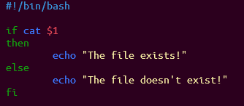
if Statement Example
Notes:
Could replace with a demonstration

Slide 16
Return codes
0 = Command executed successfully
1 or more = Command did not execute successfully
Notes:
#!/bin/bash
cat file.txt
if [ $? -eq 0 ]
then
echo "The script ran ok"
exit 0
else
echo "The script failed" >&2 exit 1
fi

Slide 17
if Statement Example
Notes:
Could replace with a demonstration

Slide 18
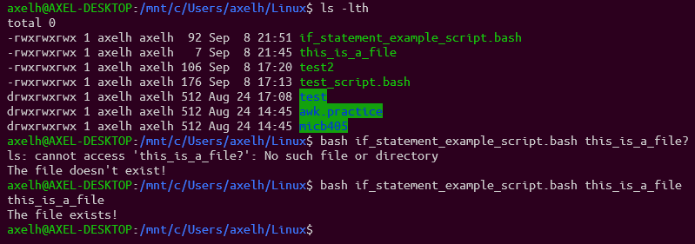
if Statement Example Output

Slide 19
test statements
Like other programs, test exits with either 0 or 1.
Test statements can be included at the beginning of the if program using
However test’s exit status indicates the return value of the test specified through its arguments, rather than exit success or error.
test supports numerous standard comparison operators.

Slide 20
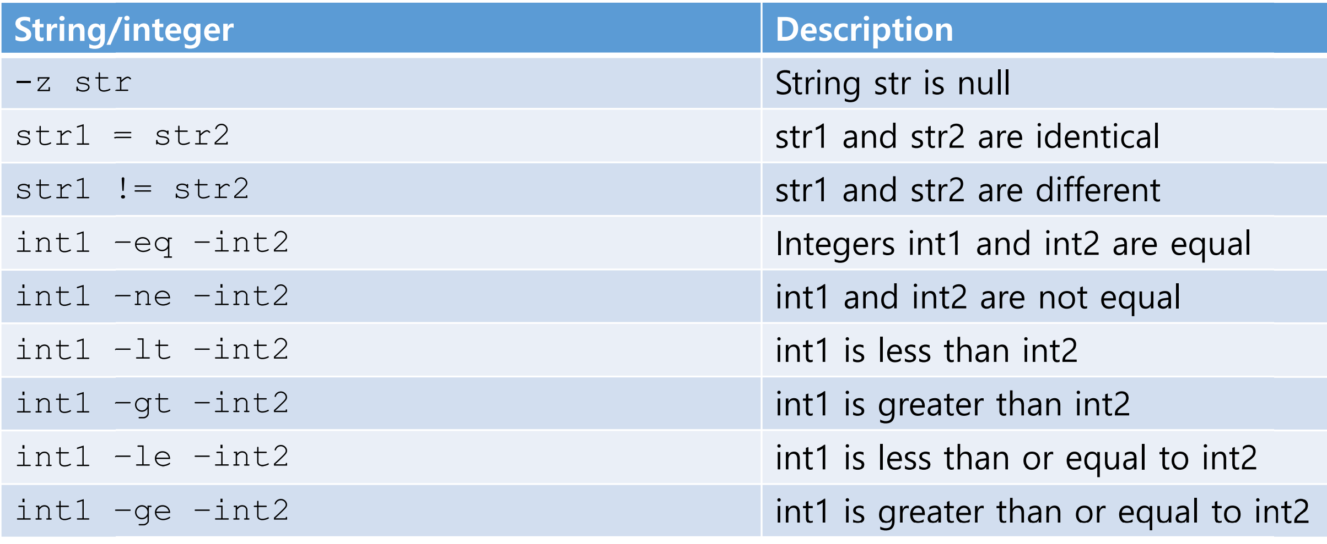
test Summary

Slide 21
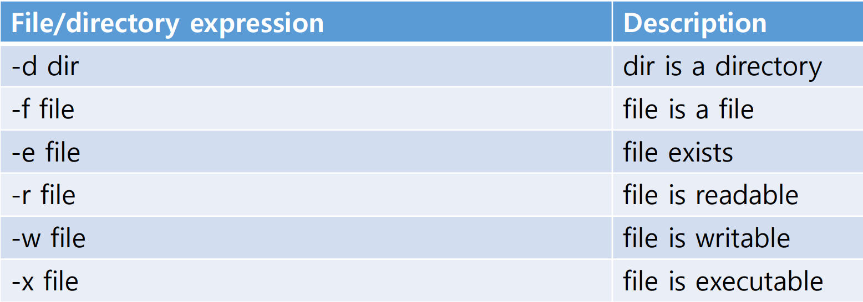
test Summary for Files/Directories

Slide 22
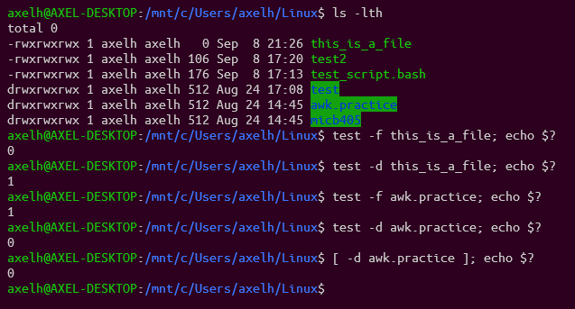
test Example
Notes:
Exit codes accompany the execution of every file. By echoing the exit statement on the same line we can display the exit code for the command, which is temporarily kept in the $? Variable during the execution of the command.
Test statements can be recreated using brackets

Slide 23
Putting it all together…

Slide 24
if Statements + test Statements
Combining test with if statements is simple:
#!/bin/bash
if [ –f some_file.txt ]
then
ACTION TO PERFORM
else
ACTION TO PERFORM
fi
Note the spaces around and within the brackets: these are required.
Notes:
If this some_file.txt is present as a file, perform this action
Otherwise, do this!

Slide 25
for loops
In bioinformatics, most of our data is split across multiple files.
Many processing pipelines need a way to apply the same workflow on each file, taking care to keep track of sample names.
Looping over files with Bash’s for loop = simplest way to accomplish this
Three essential parts to creating a pipeline to process a set of files:
Selecting which files to apply the commands to
Looping over the data and applying the commands
Keeping track of the names of any output files created

Slide 26
for loops
#!/bin/bash
for (variable) in (directory/array/etc.)
do
ACTION TO PERFORM
ANOTHER ACTION TO PERFORM
done

Slide 27
for looping through directories
Creating for loops that loop through an entire directory
Summarize_files.bash
#!/bin/bash
for foo in /home/axelh/Documents/data/*
do
head ${foo} > ${foo}.head.and.tail.txt
tail ${foo} >> ${foo}.head.and.tail.txt
done

Slide 28
for looping through directories
#!/bin/bash
for foo in /home/axelh/Documents/data/*
do
if [ -f ${foo} ]
then
head ${foo} > ${foo}.head.and.tail.txt
tail ${foo} >> ${foo}.head.and.tail.txt
else
echo “${foo} is not a file to summarize!”
fi
done

Slide 29
Breakout Groups
Notes:
Complete the last problems that require for loops

Slide 30
Looping through a specified array
~$ cat file_list.txt
File1
File2
File3

Slide 31
Looping through a specified array
#!/bin/bash
my_file_list=/home/axelh/file_list.txt
for bar in my_file_list
do

